Slide 1
Life Processes 1.Transportation 2.Excretion
CHAPTER SIX-6.3

Slide 2
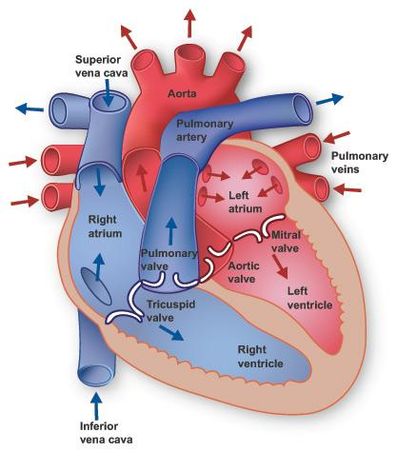
Transportation
Notes:
Add video – transportation of oxygen and co2 in human (arteries and veins)

Slide 3
The tubes – blood vessels
Blood vessels Arteries are the vessels which carry blood away from the heart to various organs of the body.
Veins – are blood vessels that carry blood toward the heart.

Slide 4
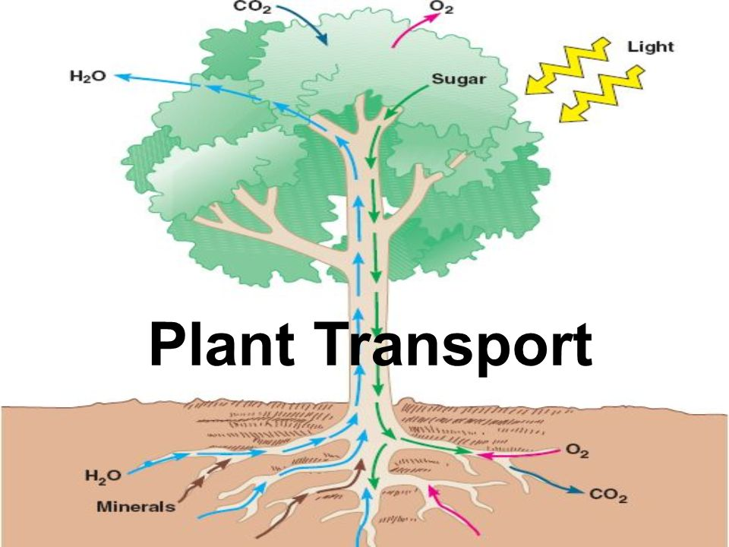
Transportation in Plants
Notes:
Add video on transportation in plants

Slide 5
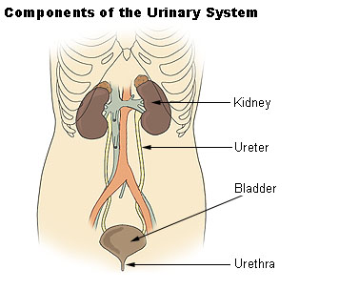
Excretion in Human Beings
Notes:
Add video on human excretion system

Slide 6
Excretion in Plants
Plants use completely different strategies for excretion than those of animals.
Oxygen itself can be thought of as a waste product generated during photosynthesis.
They can get rid of excess water by transpiration.
plants use the fact that many of their tissues consist of dead cells, and that they can even lose some parts such as leaves. Plants also excrete some waste substances into the soil around them.
Notes:
Add video of plants excretion system

